Slide 1

بسم الله الرحمن الرحیم

Slide 2
Dr Fatemeh Tabatabaei, fellowship of gynecologic laparoscopic surgeries, assistant professor of Tabriz university of medical sciences, alzara hospital, Tabriz, Iran
oral contraceptive pills

Slide 3
Combined estrogen-progestin oral contraceptives (COCs)
Low-dose COCs (formulations containing <50 mcg ethinyl estradiol) are a safe and reliable contraceptive option.
For healthy, nonsmoking women, COCs may be continued until the age of menopause.

Slide 4
APPROACH TO COC SELECTION
Generic versus brand name
Monophasic versus multiphasic
Cyclic versus extended-cycle versus continuous use regarding the frequency of withdrawal bleeding. Some may prefer monthly withdrawal bleeding, while others may opt for every three months (84/7 formulations) or prefer no withdrawal bleeds (365 day formulations).

Slide 5
APPROACH TO COC SELECTION
Ethinyl estradiol dose – Women should be prescribed a COC with 35 mcg of ethinyl estradiol or less. The data regarding safety of 20 mcg versus 25, 30, or 35 mcg ethinyl estradiol COCs are not strong enough to endorse higher safety with 20 mcg pills.
Nevertheless, it makes sense to start with a 20 mcg dose, and the dose can be increased if unscheduled bleeding is a problem.
COCs containing 50 mcg of ethinyl estradiol should not be used for contraception but are available for the acute treatment of uterine bleeding.

Slide 6
APPROACH TO COC SELECTION
Progestin type – Given that all COCs are antiandrogenic when the effects of both estrogen and progestin are considered, we do not preferentially prescribe based on progestin type even when considering hyperandrogenic symptoms. The data surrounding venous thromboembolism risk and progestin type are conflicting. There may be a slightly increased risk with newer progestins (gestodene, desogestrel, and drospirenone) compared with levonorgestrel; however, the absolute risk is extremely low for all COCs. The evidence is not compelling enough to change prescribing patterns.

Slide 7
APPROACH TO COC SELECTION
21/7 versus 24/4 –
We prefer 24/4 to 21/7 formulations if feasible due to emerging evidence about increased efficacy (especially for obese women) and decreased hormone withdrawal side effects during the hormone-free interval

Slide 8
MECHANISMS OF ACTION
The main contraceptive efficacy is suppression of ovulation by inhibition of gonadotropin-releasing hormone (GnRH), luteinizing hormone (LH), follicle-stimulating hormone (FSH) and the mid-cycle LH surge. This effect is mediated by both the progestin and estrogen component of the COC working synergistically, but estrogen suppression of FSH, which in turn prevents folliculogenesis, is likely the most important mechanism.
Effects on the endometrium, rendering it less suitable for implantation. Long-term cyclic or daily progestin exposure leads to endometrial decidualization and eventual atrophy.
Thickening of cervical mucus, becomes less permeable to penetration by sperm.
Impairment of normal tubal motility and peristalsis.

Slide 9
CANDIDATES (both the World Health Organization (WHO) and the Centers for Disease Control and Prevention (CDC) …. Unacceptable risk
≥35 years and smoking ≥15 cigarettes per day
Multiple risk factors for arterial cardiovascular disease (such as older age, smoking, diabetes, and hypertension)
Hypertension (systolic ≥160 mmHg or diastolic ≥100 mmHg)
Venous thromboembolism (VTE; unless on anticoagulation)
Known ischemic heart disease,,,,,,,,,,,,,,,,,, History of stroke,,,,,,,,,,,,,,, Migraine with aura
Complicated valvular heart disease (pulmonary hypertension, risk for atrial fibrillation, history of subacute bacterial endocarditis)
Current breast cancer, Severe (decompensated) cirrhosis
Hepatocellular adenoma or malignant hepatoma
Diabetes mellitus of >20 years duration or with nephropathy, retinopathy, or neuropathy

Slide 10
Risks outweigh benefits
Age ≥35 years and smoking <15 cigarettes per day
Hypertension (systolic 140 to 159 mmHg or diastolic 90 to 99 mmHg)
Hypertension adequately controlled on medications
Past breast cancer and no evidence of current disease for five years
Current gallbladder disease

Slide 11
Noncontraceptive uses
Menstrual cycle disorder & Pelvic pain disorders
Ovarian cysts
Hyperandrogenism
  Inhibition of gonadotropin secretion and thereby a decrease in ovarian androgen secretion.
  An increase in serum sex hormone-binding globulin concentrations
  Inhibition of adrenal androgen secretion, the mechanism is not well understood
Cancer risk reduction
Bone health….. improved bone density
Impact on STI acquisition

Slide 12
Estrogen effects on serum globulin
The estrogen component of COC pills, like any estrogen taken orally, raises the serum concentrations of thyroxine-binding globulin (TBG), cortisol-binding globulin (CBG), and sex hormone-binding globulin (SHBG). As a result, the serum concentrations of total thyroxine (T4), triiodothyronine (T3), cortisol, estradiol, and testosterone increase, but the serum concentrations of free T4, T3, cortisol, estradiol, and testosterone do not change. This effect of oral estrogen administration needs to be considered when evaluating tests of thyroid, adrenal, and gonadal function in women taking any estrogen orally.

Slide 13
progestins
In general, third- and fourth-generation progestins are less androgenic and have fewer side effects than earlier generation progestins.
Modifications to levonorgestrel created the third-generation progestins desogestrel, gestodene, and norgestimate. However, some of these later generation progestins (desogestrel and norgestimate) have also been associated with a slightly greater risk of venous thromboembolism.

Slide 14
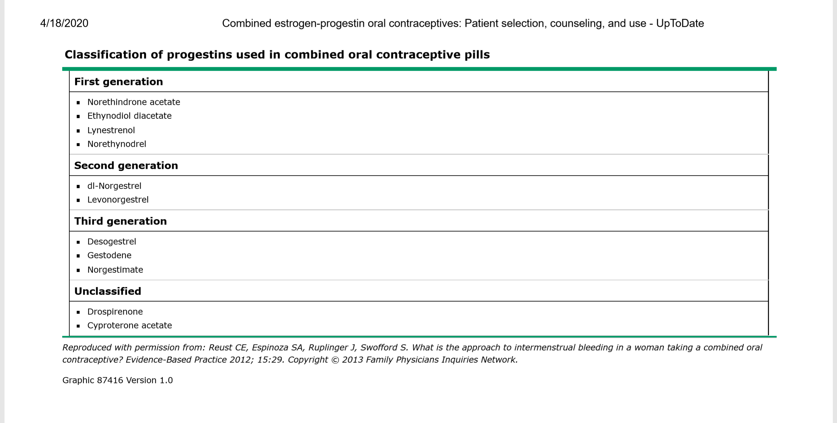

Slide 15
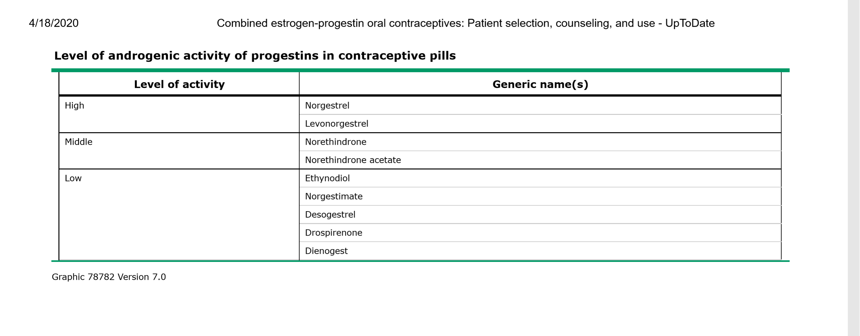

Slide 16
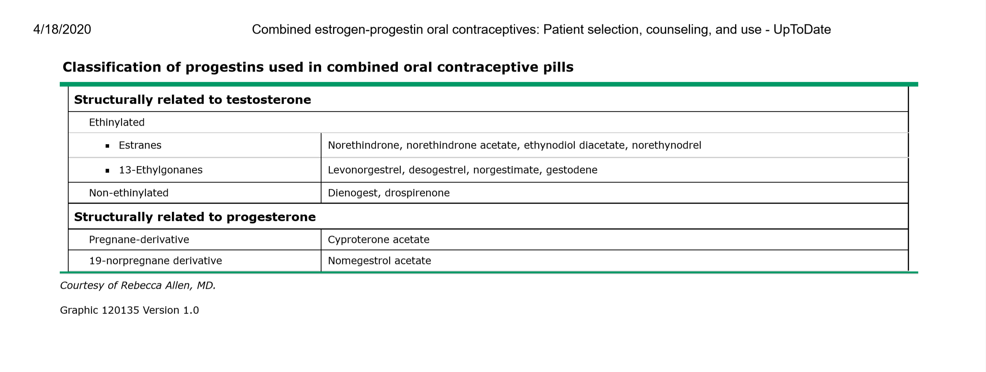

Slide 17
Antiandrogenic progestins
These include a compound derived from drospirenone (a spironolactone analog), dienogest and cyproterone acetate.
Drospirenone is structurally related to spironolactone; it has progestogenic, antiandrogenic, and anti-mineralocorticoid activity.
Drospirenone appears to be a very weak antiandrogen; the 3 mg dose is estimated to be equivalent to only 25 mg of spironolactone.
The 20 mcg preparation has a four-day pill-free interval, is approved for the treatment of premenstrual dysphoric disorder (but not for premenstrual syndrome [eg, women with milder symptoms]) . Although drospirenone is technically an antiandrogen, drospirenone-containing COCs have no advantage over other COCs for treating hirsutism or acne.

Slide 18
Other characteristics
Although drospirenone has potential potassium-sparing effects (due to its anti-mineralocorticoid activity), healthy women are no more likely to develop hyperkalemia than women taking other COC preparations.
Package labeling recommends potassium monitoring in the first month for women who take additional medications that predispose to hyperkalemia (eg, spironolactone, nonsteroidal anti-inflammatory drugs [NSAIDs], angiotensin-converting enzyme inhibitors, angiotensin II receptor antagonists, potassium-sparing diuretics, and aldosterone antagonists).
In clinical practice, we do not check potassium levels on women taking NSAIDs with drospirenone-containing COCs. Package labeling also advises against prescribing drospirenone to women with renal disease or adrenal insufficiency.

Slide 19
androgenicity
Estrogen is known to decrease low-density lipoprotein (LDL) and increase high-density lipoprotein (HDL), triglycerides, cholesterol, and SHBG. A progestin, depending on its level of androgenicity, may be neutral or may partially reverse some of these effects when the two hormones are taken together.
The overall effect of all COCs, however, is antiandrogenic, regardless of the type of progestin used. There is no evidence that a certain type of progestin in a COC formulation is any more effective in treating hyperandrogenic symptoms, such as acne or hirsutism, for example, than another type, nor are any changes in lipid profiles typically clinically meaningful for the average woman

Slide 20
Cyclic use
A four-day pill-free interval, on the other hand, endometrial atrophy may become more likely. Then again, the four-day hormone-free interval may be associated with increased efficacy.
Furthermore, shortening the hormone-free interval may reduce symptoms associated with hormone withdrawal (eg, mood symptoms, headache, pelvic pain)

Slide 21
Continuous use
Endometriosis
Premenstrual dysphoric disorder (PMDD)
Hyperandrogenism
Lifestyle needs
Management of menopausal symptoms in perimenopausal women – Hot flashes recur if COCs are given in a cyclic regimen but will remain suppressed with a continuous regimen.
Dysmenorrhea

Slide 22
DRUG INTERACTIONS
Anticonvulsants: women taking anticonvulsants including phenytoin, carbamazepine, barbiturates, primidone, topiramate, felbamate, or oxcarbazepine should generally not use COCs because the anticonvulsant may reduce the efficacy of the hormonal contraceptive.
When a COC is chosen, a formulation containing a minimum of 30 mcg of ethinyl estradiol should be used, and consideration should be given to using progestins with a longer half-life (drospirenone, desogestrel, levonorgestrel) and a continuous regimen or a preparation with a four-day hormone-free interval.
Anticonvulsants that do not appear to reduce contraceptive efficacy include gabapentin, levetiracetam, valproate, zonisamide, and tiagabine.
By contrast, COCs increase lamotrigine clearance , resulting in a decrease in plasma lamotrigine concentrations by 45 to 60 percent. This interaction raises concerns about adequate seizure control if a COC and lamotrigine are used in combination, and the lamotrigine dose may need to be adjusted. To avoid fluctuating levels of lamotrigine, we recommend using continuous dosing of the COC rather than cyclic.

Slide 23
Antibiotics – Rifampin is the only antibiotic proven to decrease serum ethinyl estradiol and progestin levels in women taking COCsو similar to liver enzyme-inducing anticonvulsants, other methods of contraception are recommended.
In spite of anecdotal reports of COC failure, other antibiotics have not been proven to affect the pharmacokinetics of ethinyl estradiol.
For women taking antibiotics other than rifampin with COCs, backup contraception is not required.
Griseofulvin, an antifungal agent, has been associated with contraceptive failure in several case reports. However, data are limited, and the World Health Organization concludes that hormonal contraception is reasonable for women on griseofulvin.
Antiretrovirals – Drug interactions between COCs and many of the drugs used to treat HIV infection are discussed elsewhere.

Slide 24
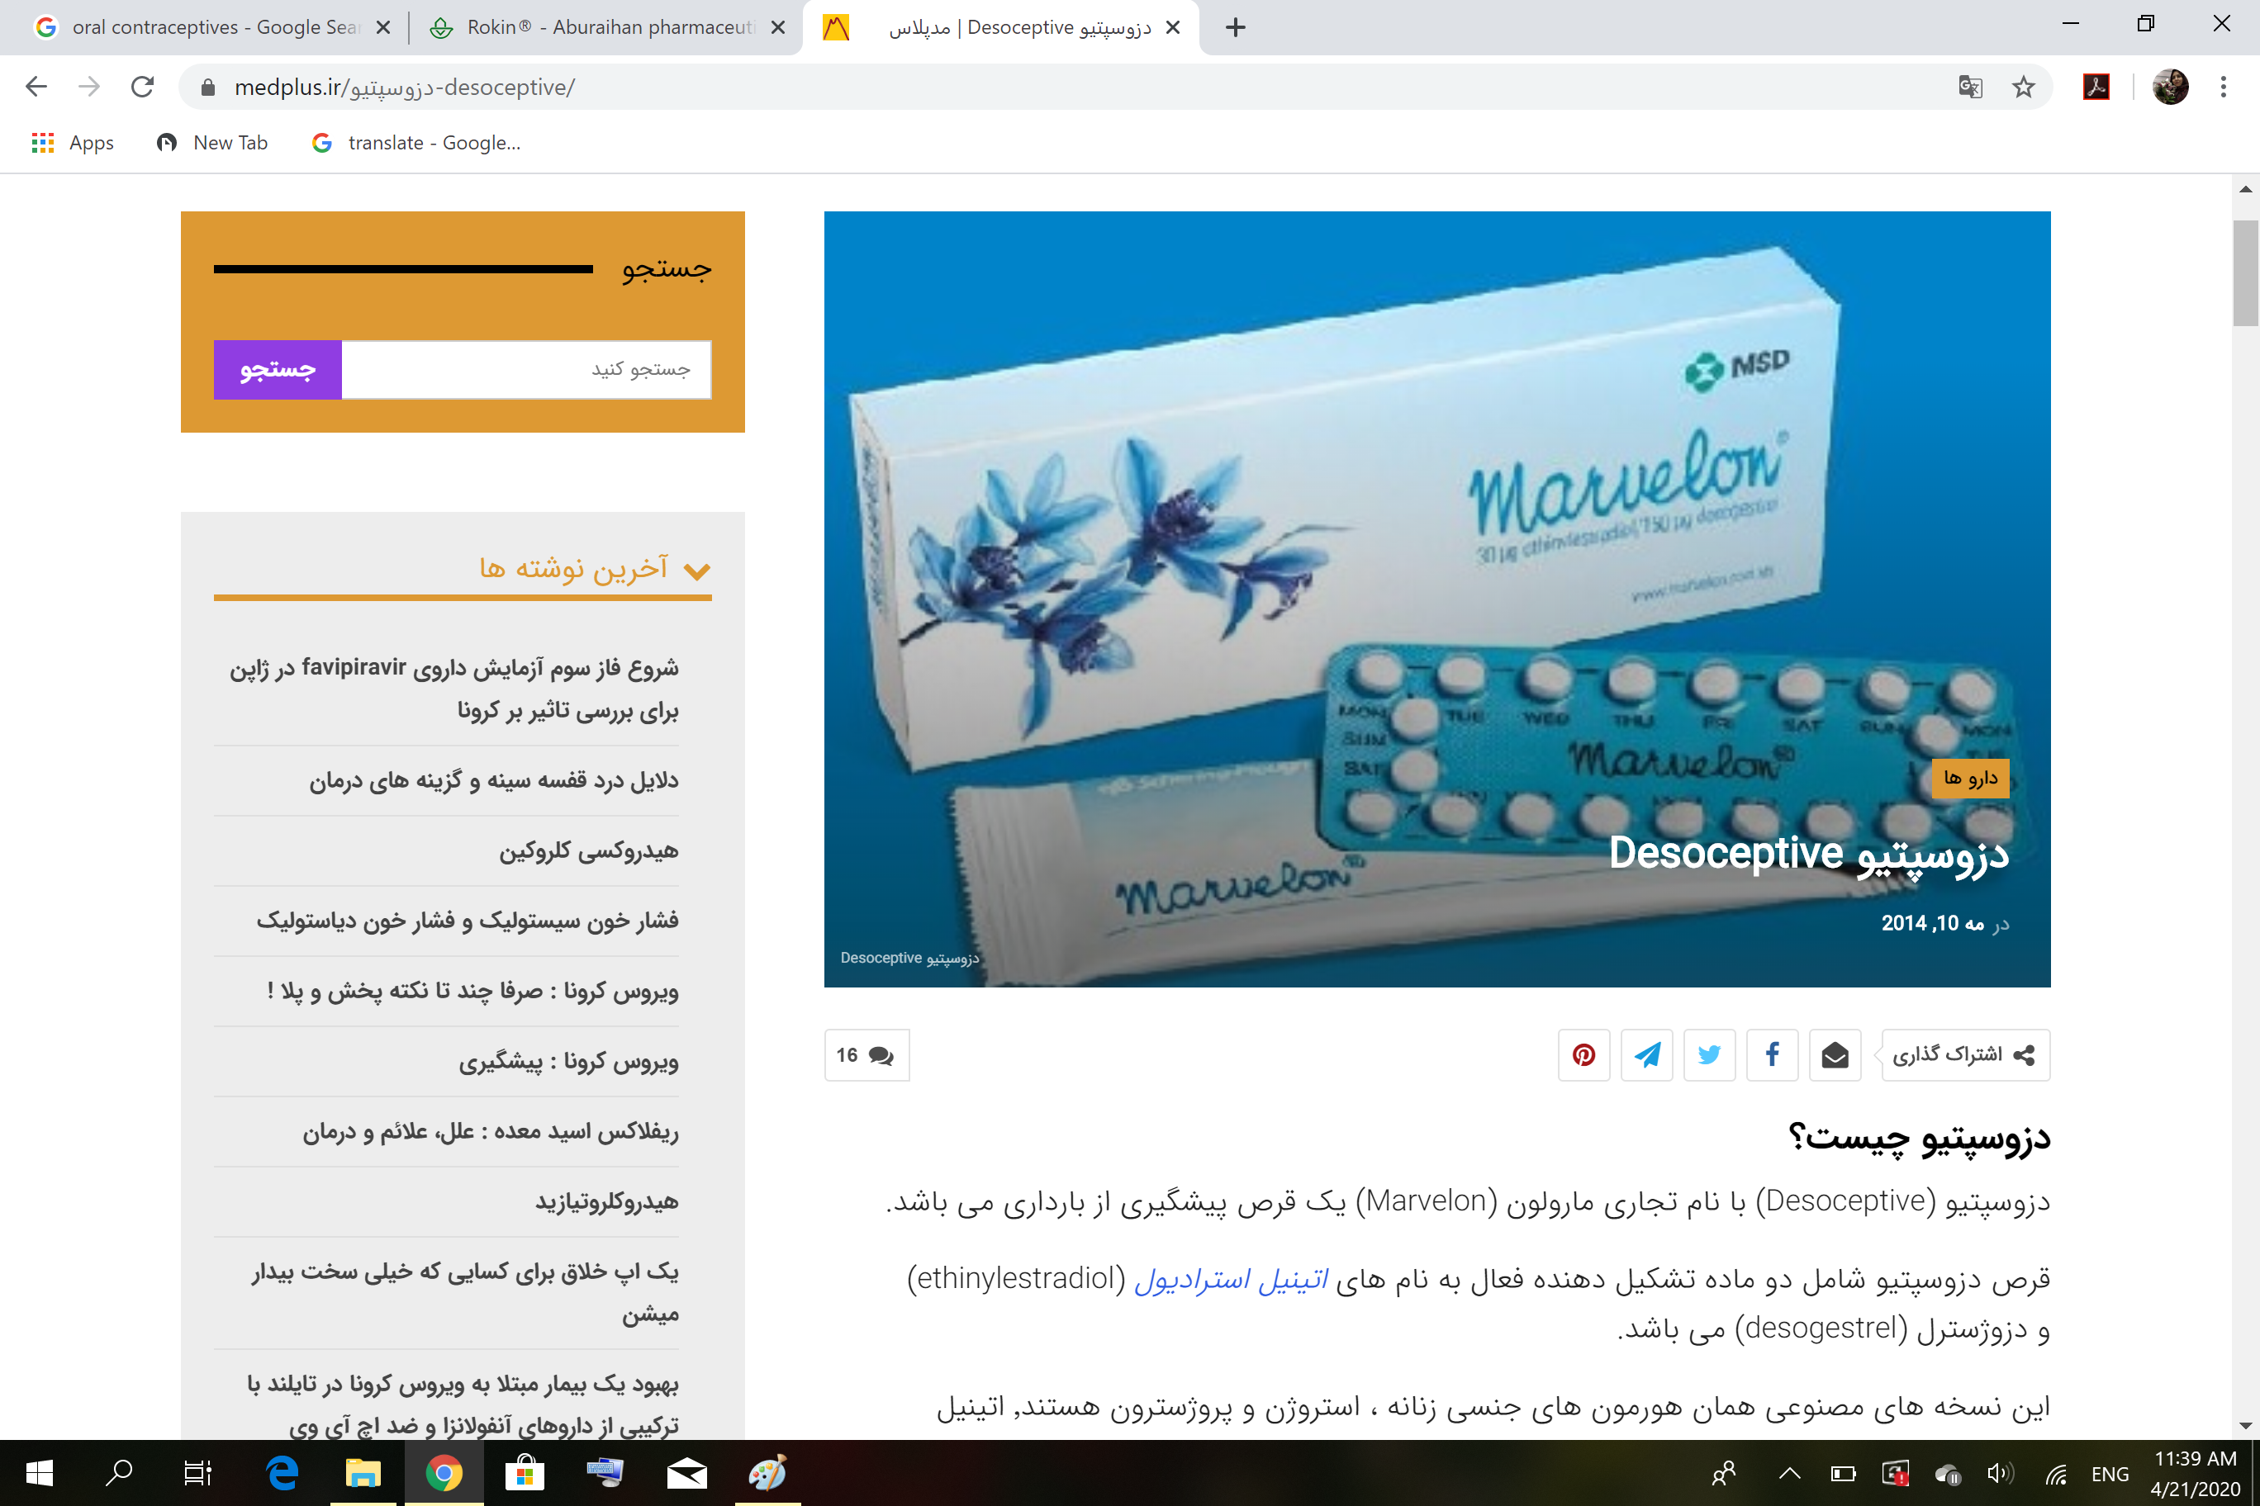

Slide 25
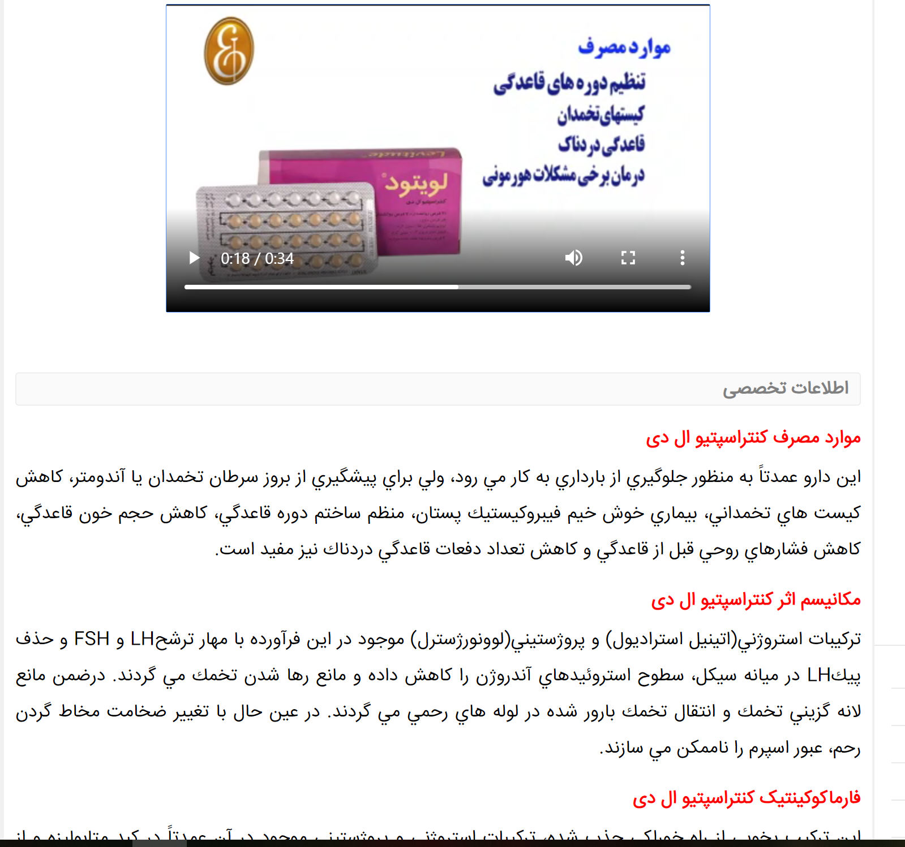

Slide 26
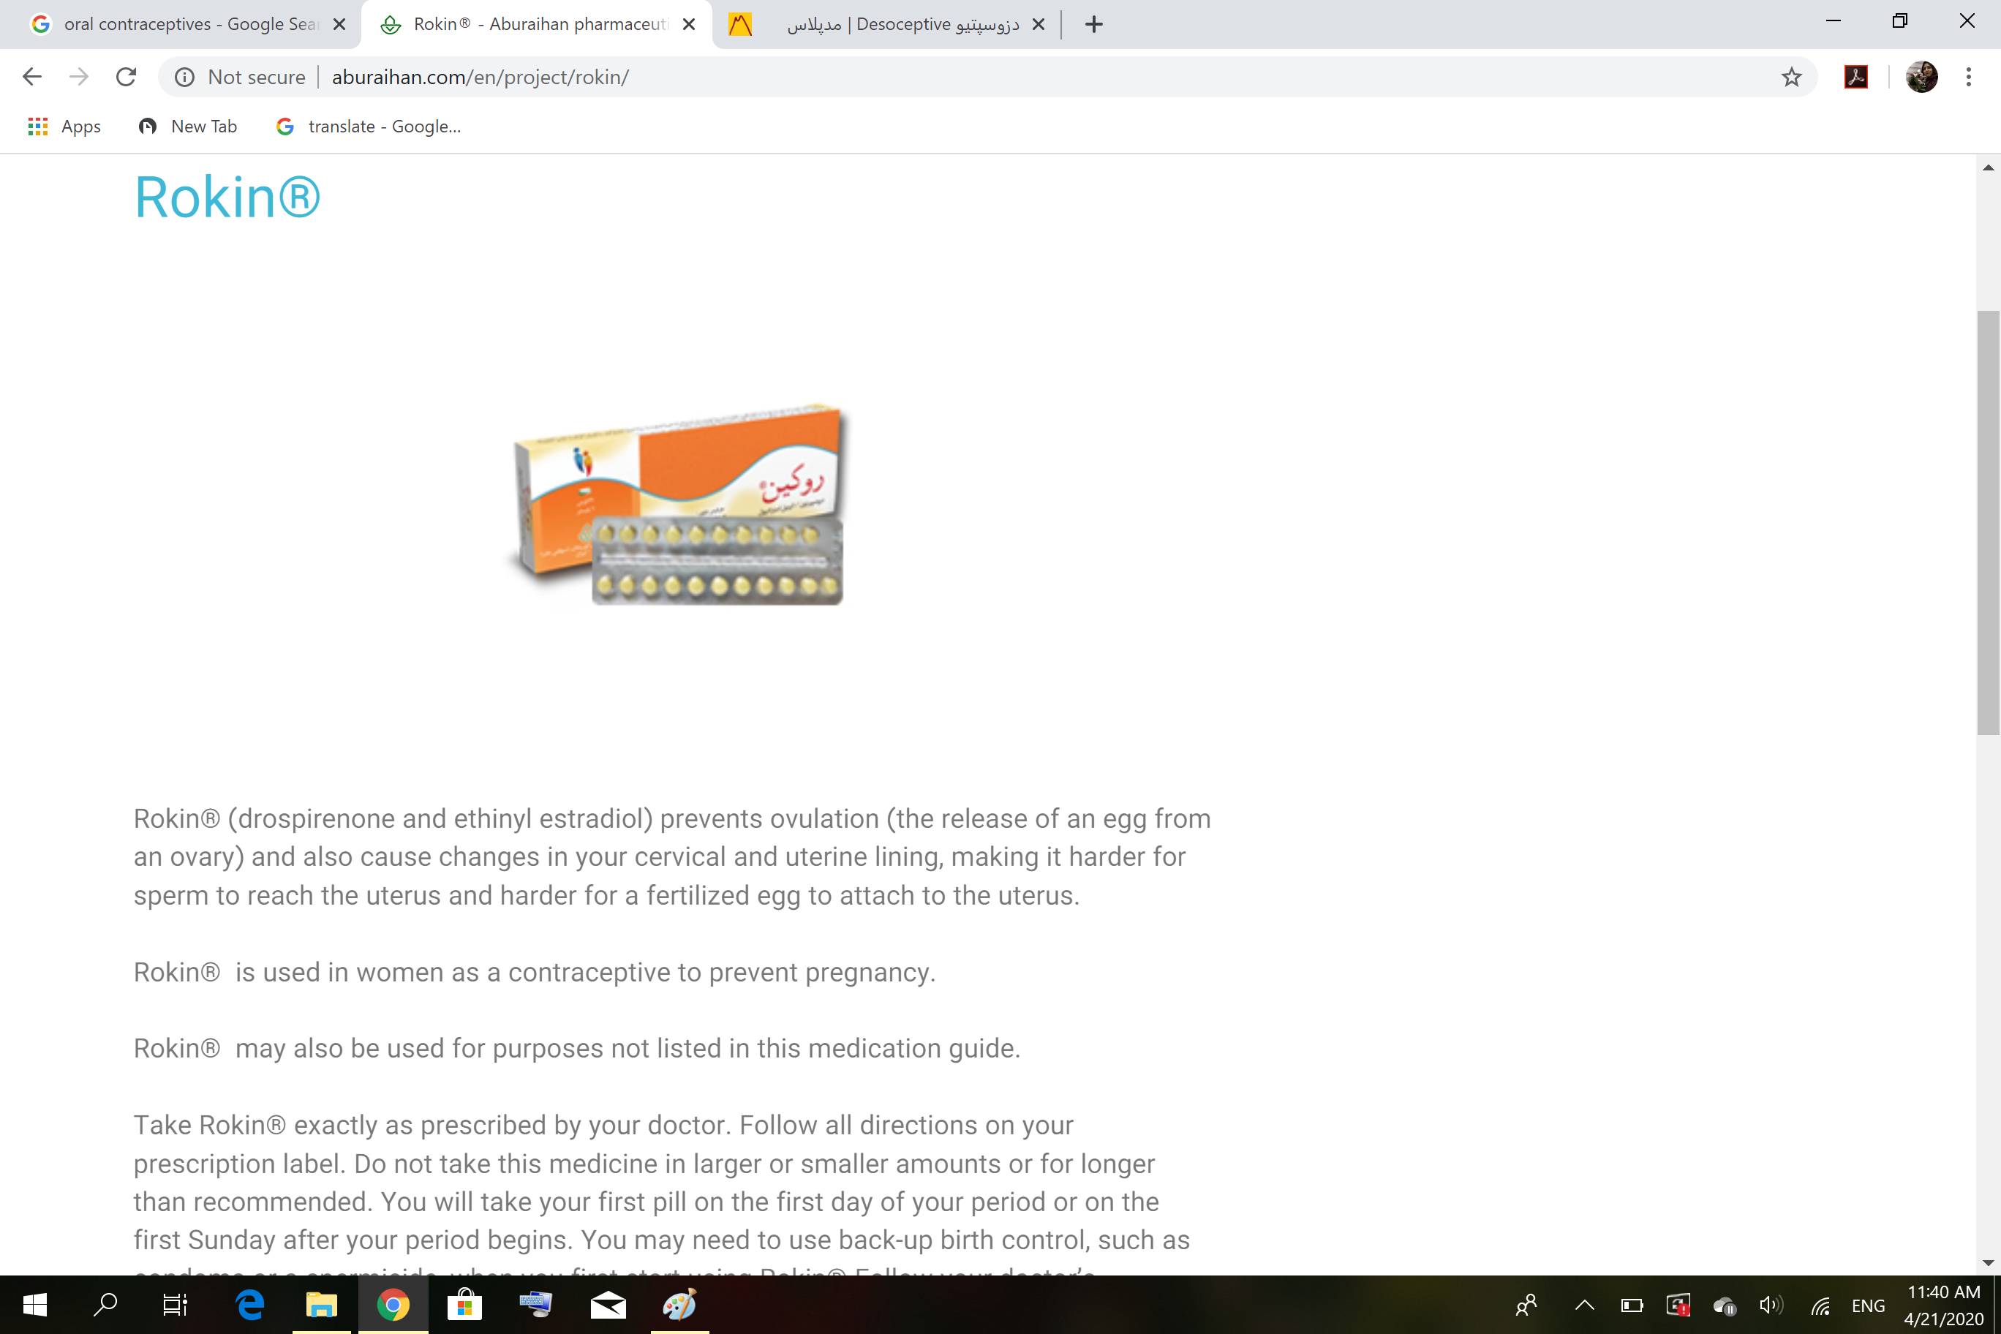

Slide 27


Slide 28


Slide 29
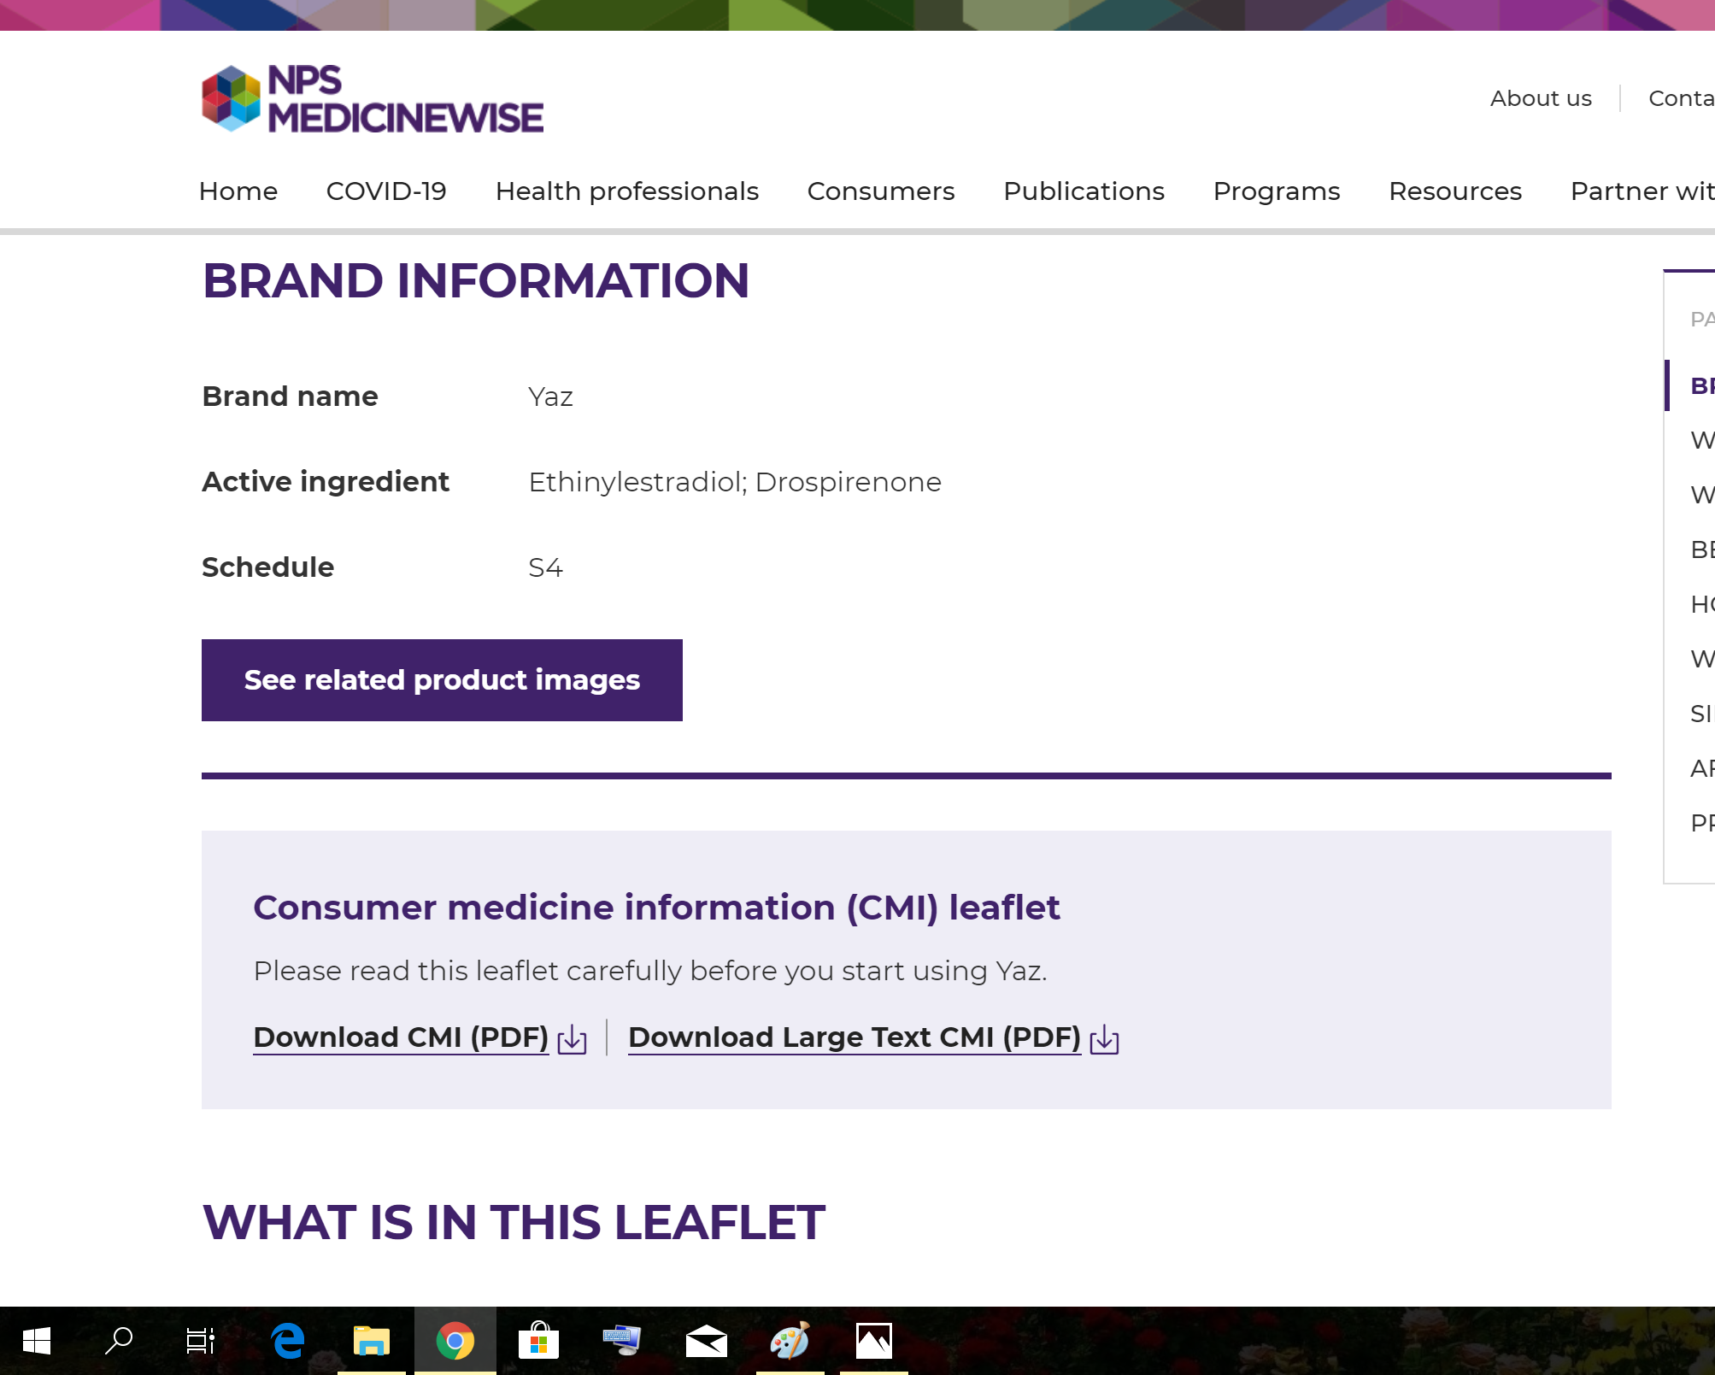

Slide 30
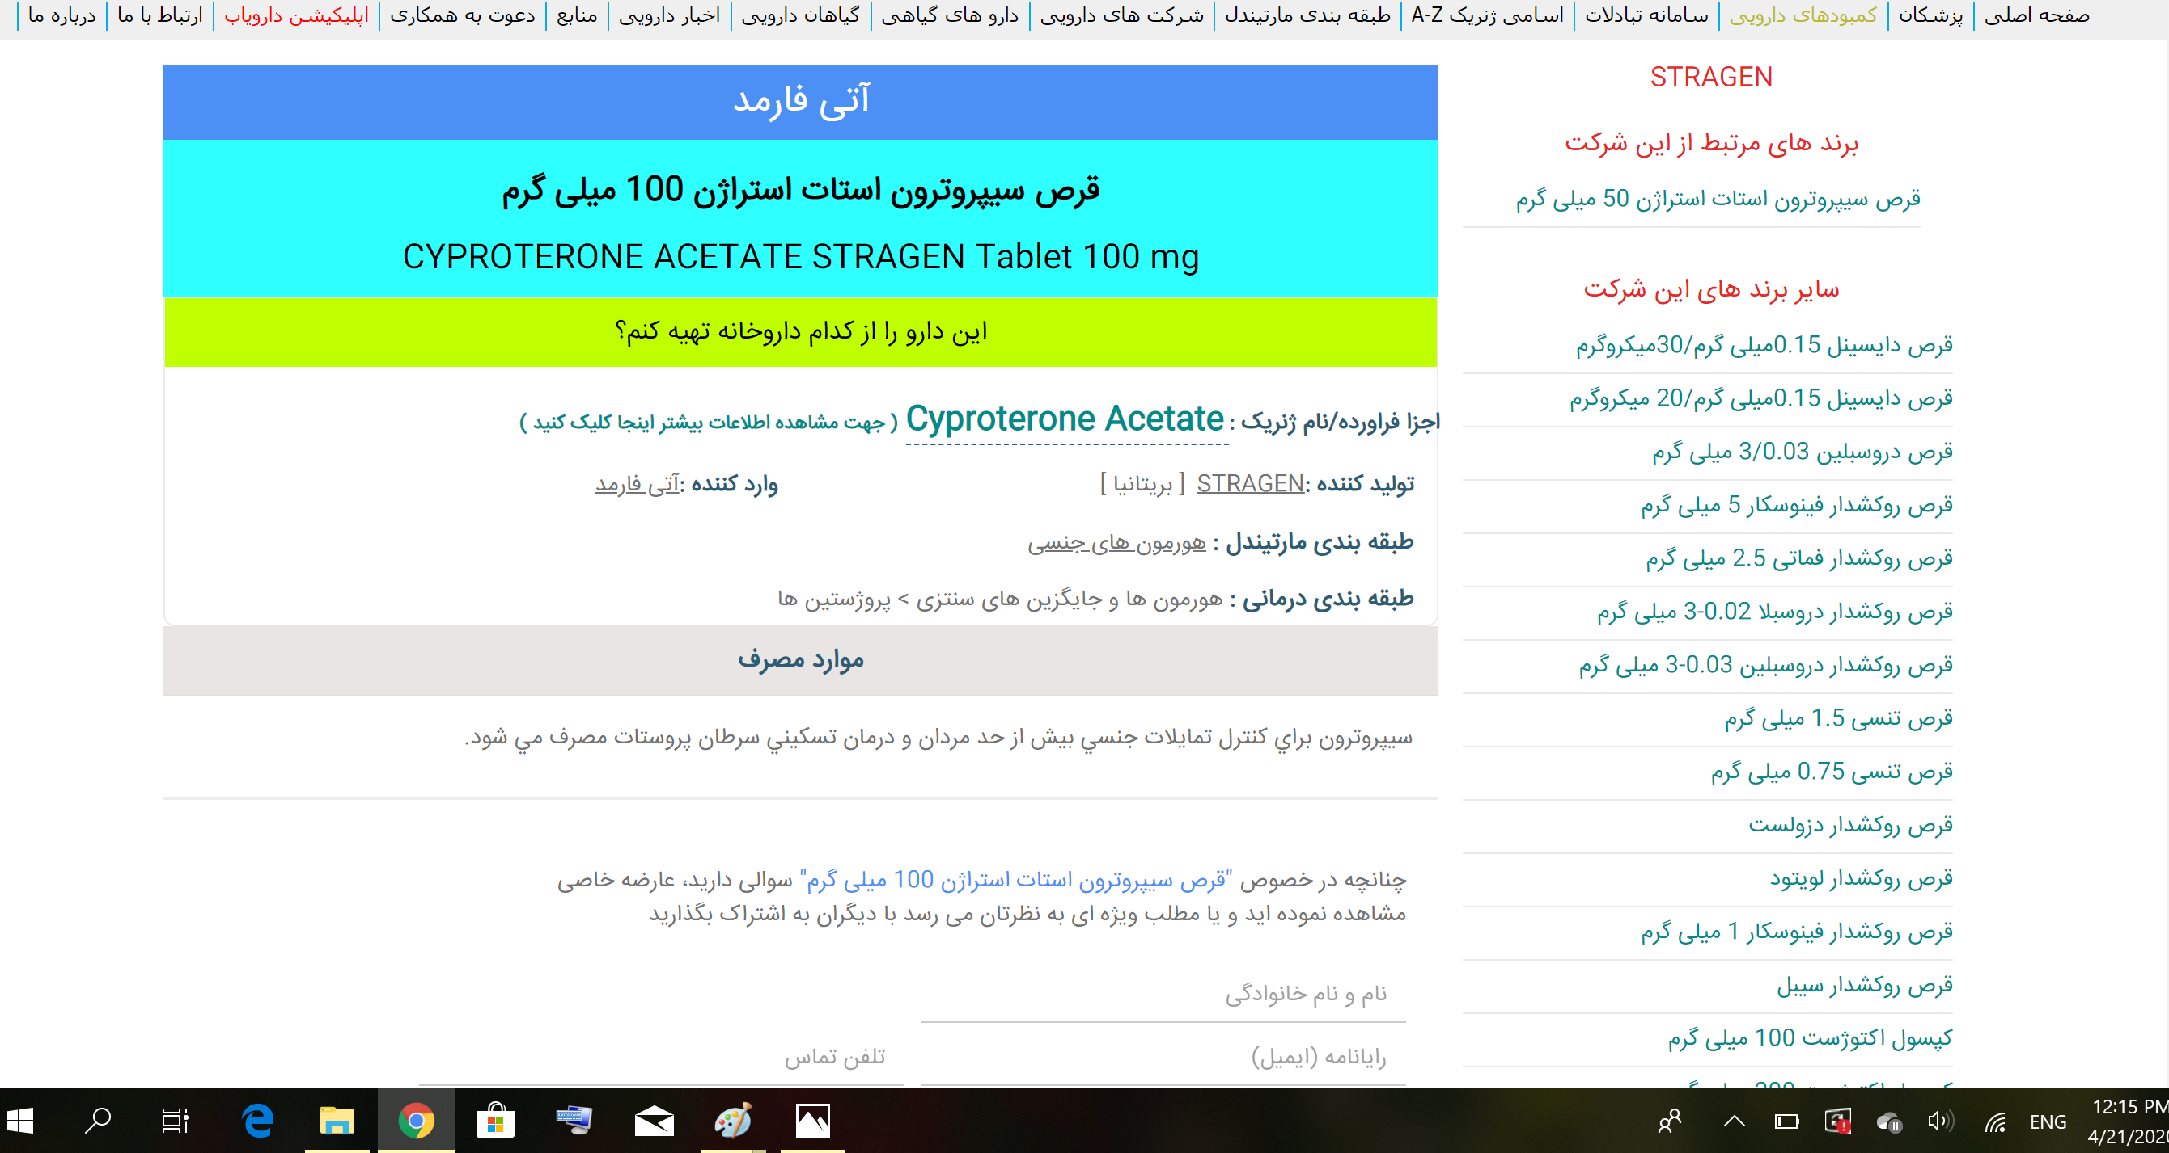

Slide 31
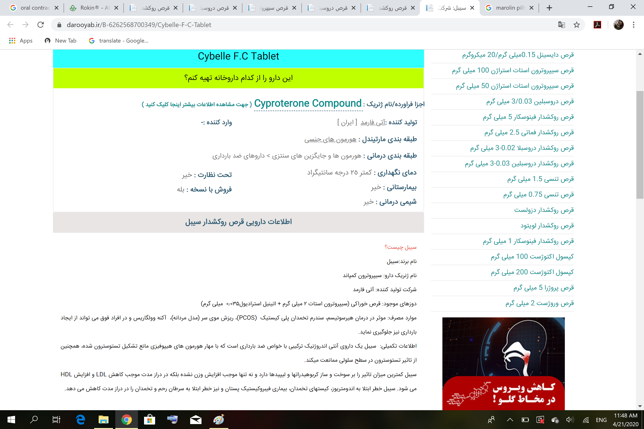

Slide 32
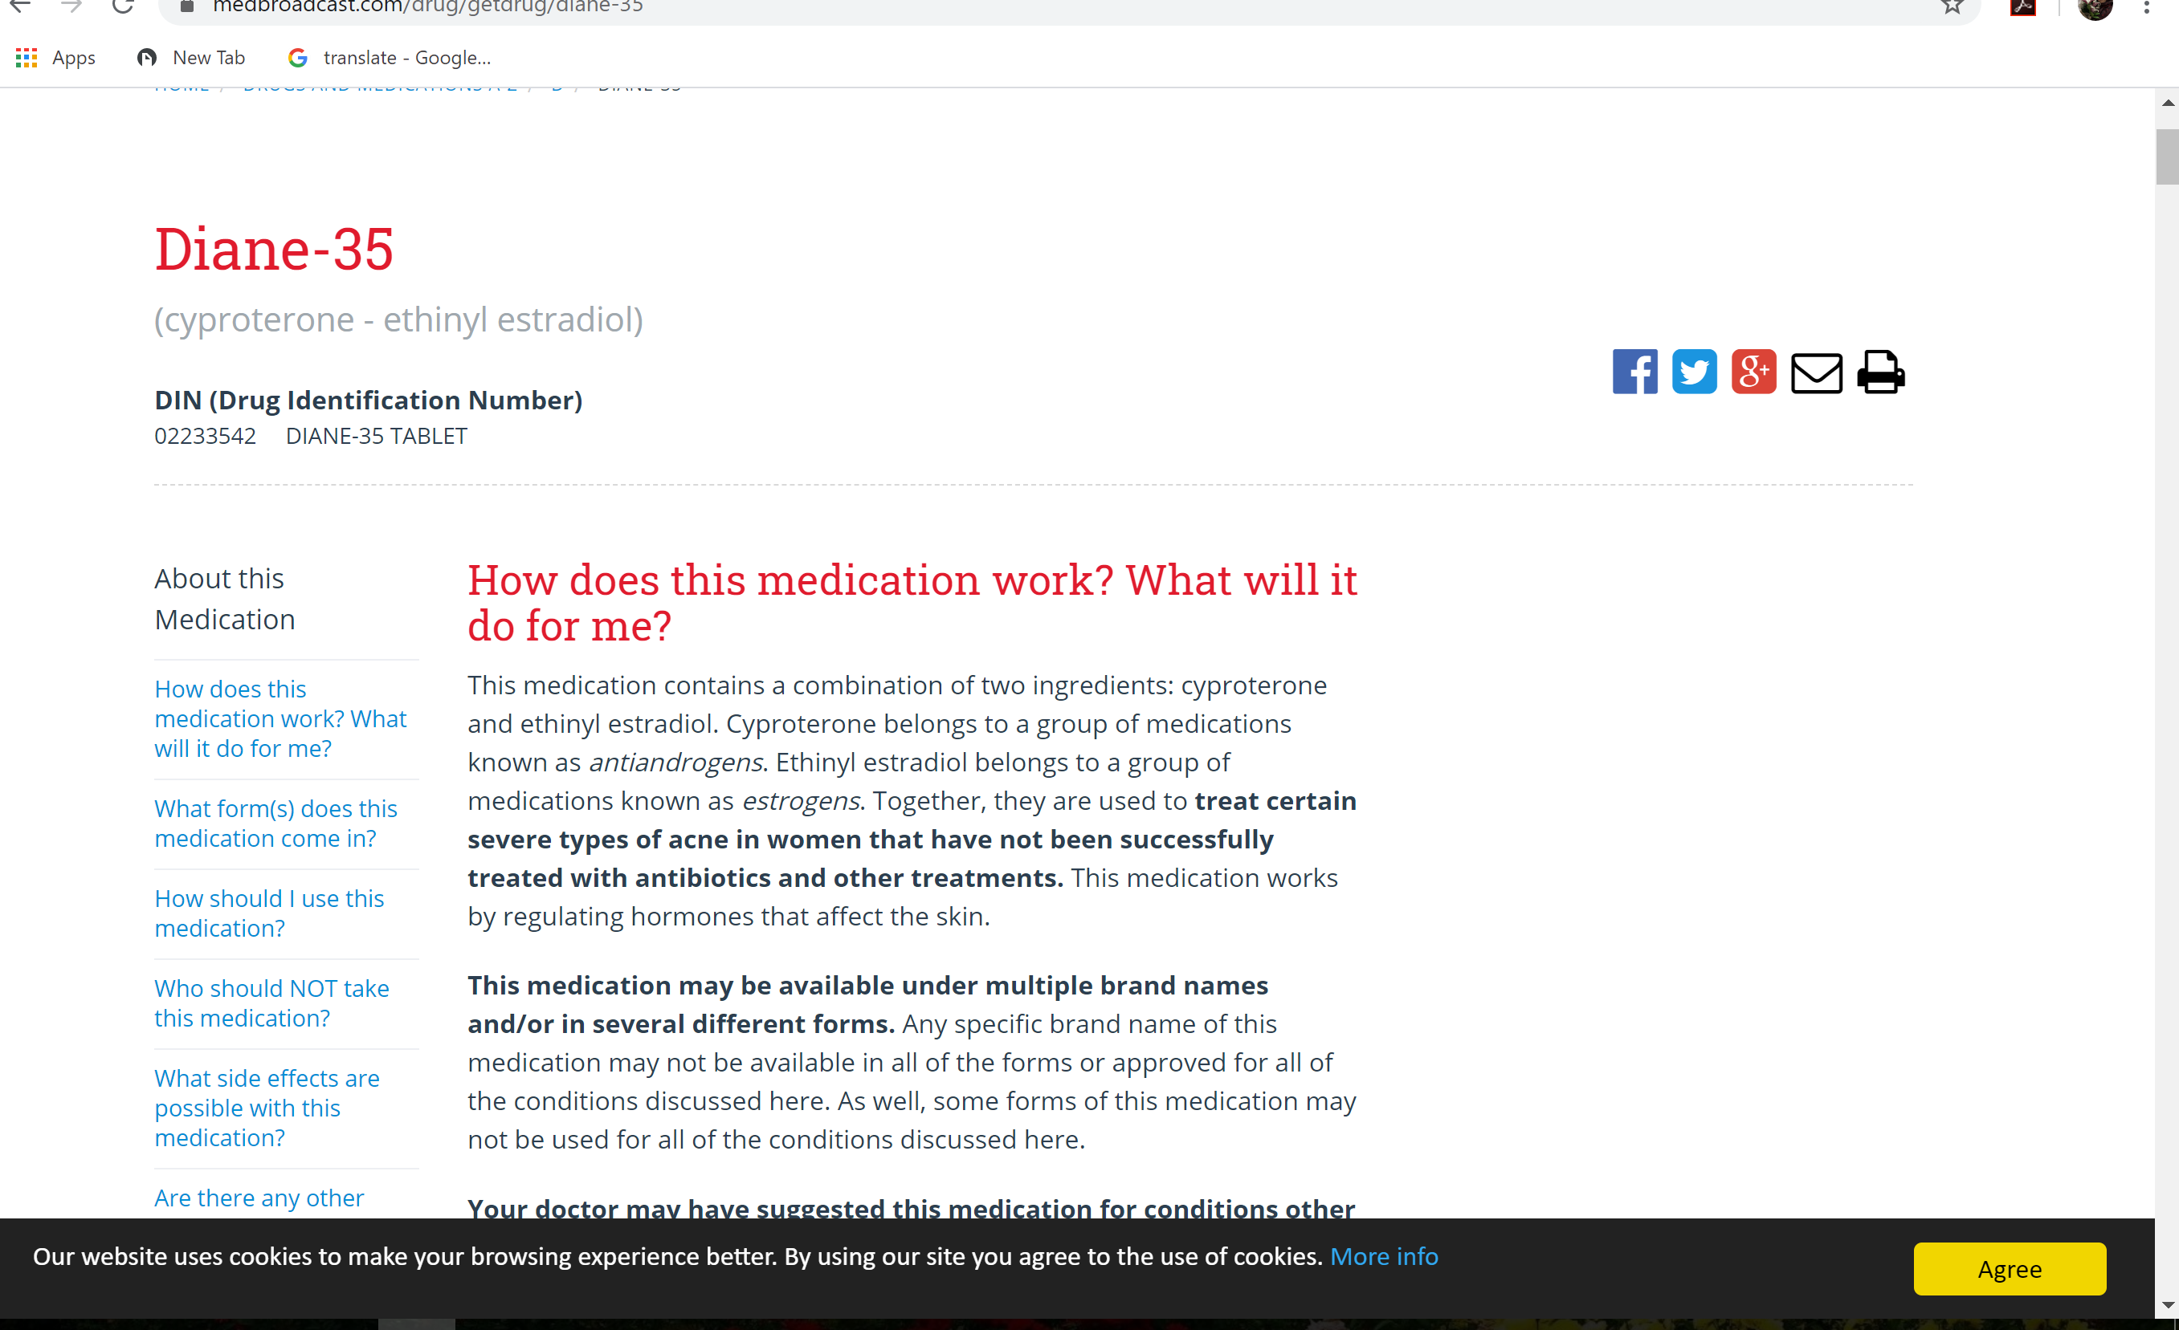

Slide 33
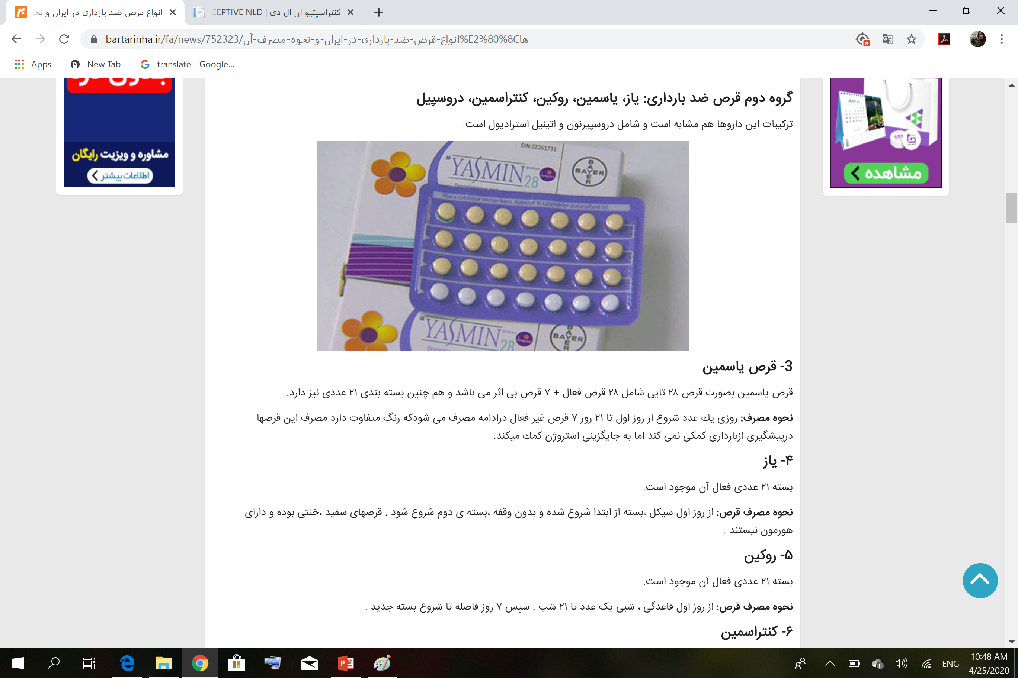

Slide 34
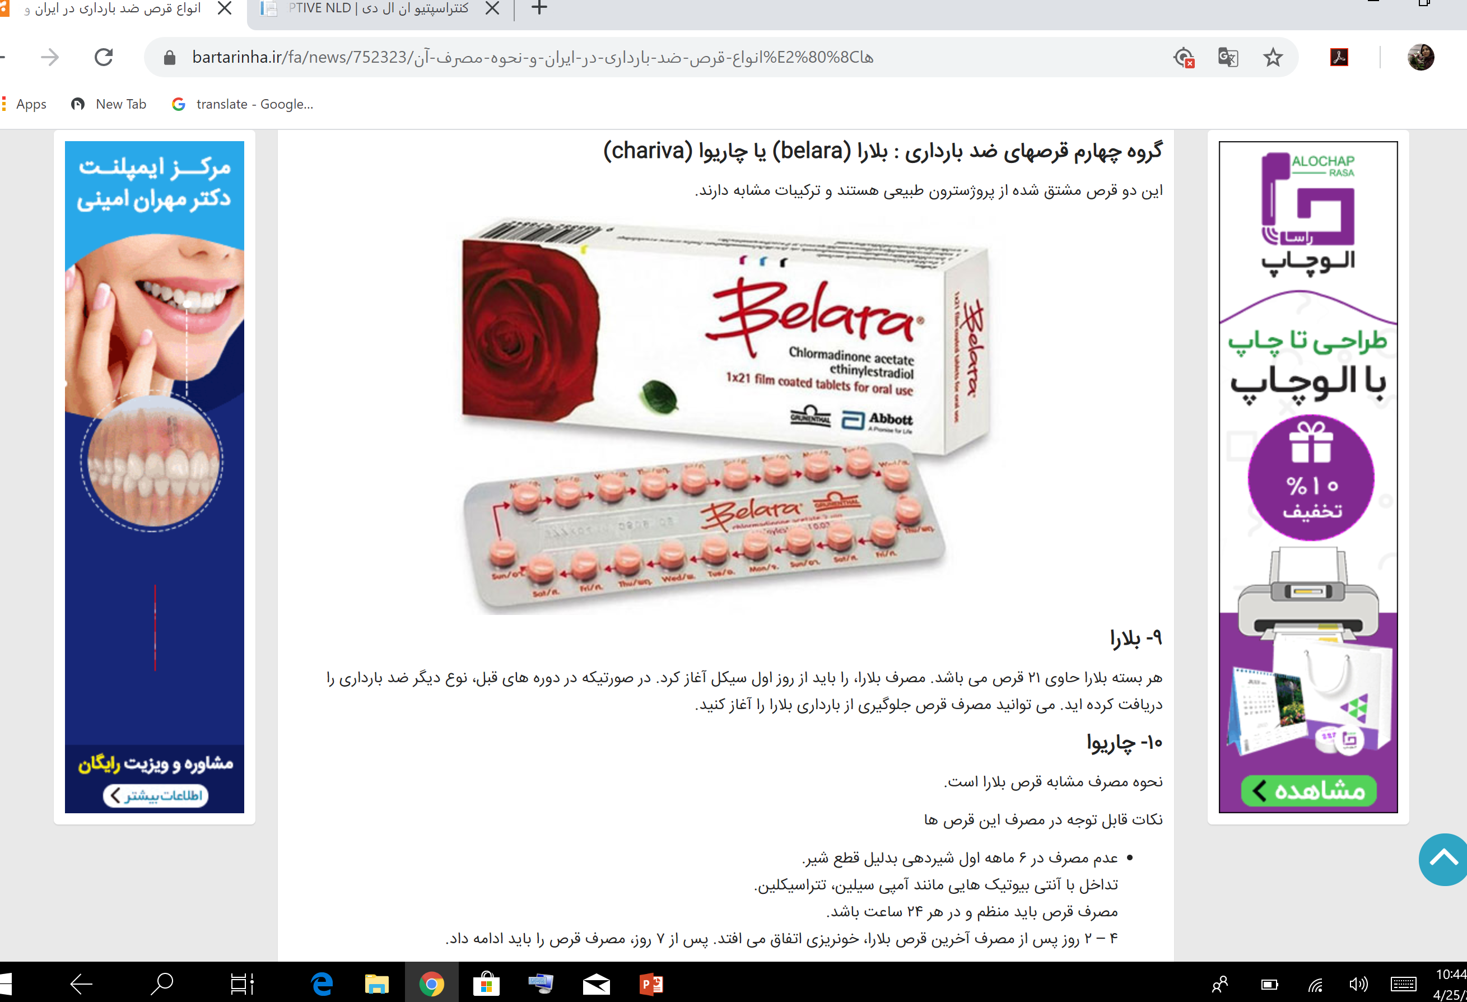

Slide 35
Megestrol acetate 40 to 160 mg daily. This medication is considered a "chemotherapeutic agent," but it is best classified as a strong progestin. Although there is practice variation based on shared decision-making with patients, megestrol is often our first choice of an oral progestin to treat atypical EH because it is a strong progestin.
MPA 10 to 20 mg daily. MPA was one of the first-line therapies for non-atypical EH before the LNg52/5 was studied for this indication.
Norethindrone acetate (NETA; also known as norethisterone acetate) 15 mg daily has not been well studied. Two studies with small numbers of women taking NETA suggest similar efficacy to MPA. However, a randomized study of NETA (15 mg/day) compared with depot MPA (DMPA) showed that DMPA results in a higher rate of regression of non-atypical EH.
Micronized progesterone 200 to 300 mg daily was beneficial in a single study of women with EH without atypia. However this is a relatively weak progestin, and we do not consider it for first-line progestin treatment for EH.

Slide 36
Depot-medroxyprogesterone acetate (Depo-Provera)
The mechanism of action is different from the other lower-dose, progestin-only methods because, in addition to thickening of the cervical mucus and alteration of the endometrium, the circulating level of the progestin is high enough to effectively block the LH surge, and, therefore, ovulation does not occur.
FSH is not suppressed therefore, follicular growth is maintained sufficiently to produce estrogen levels comparable to those in the early follicular phase of a normal menstrual cycle.
Symptoms of estrogen deficiency, such as vaginal atrophy or a decrease in breast size, do not occur.

Slide 37
Absolute Contraindications & Relative Contraindications
Pregnancy
2. Unexplained genital bleeding
3. Severe coagulation disorders
4. Previous sex steroid–induced liver adenoma
Liver disease
2. Severe cardiovascular disease
3. Rapid return to fertility desired
4. Difficulty with injections 5. Severe depression

Slide 38
Key Points: Summary of Advantages
Easy to use, no daily or coital action required, very effective
Safe, no serious health effects, is an excellent contraceptive choice for women taking antiepileptic drugs because the high progestin levels raise the seizure threshold. An improvement in seizure control can be achieved probably because of the sedative properties of progestins.
Women who are anticoagulated, we would expect a beneficial reduction in bleeding and a reduced risk of ovarian hemorrhage, especially from a corpus luteum.
Decreased risk of endometrial cancer, decreased development of uterine fibroids, decreased risk of ectopic pregnancy and less pelvic inflammatory disease
Free from estrogen-related problems ,,,,,,,,,,,,,,,,,,,,Private, use not detectable
Lactation enhanced , WHO could find no evidence for increased risks of stroke, myocardial infarction, or venous thromboembolism.

Slide 39
Problems with Depot-Medroxyprogesterone Acetate
Irregular menstrual bleeding, breast tenderness, weight gain, fatigue and depression.
If necessary, breakthrough bleeding can be treated with exogenous estrogen, 1.25 mg conjugated estrogens, or 2 mg estradiol, given daily for 7 days. A nonsteroidal antiinflammatory product given for a week is also effective, and another option is to administer an oral contraceptive for 1–3 months.
A very large, case-control WHO study conducted over 9 years in three developing countries indicated that exposure to DMPA is associated with a very slightly increased risk in breast cancer in the first 4 years of use, but there was no evidence for an increase in risk with increasing duration of use.
No increase in adenocarcinoma or adenosquamous carcinoma of the cervix could be detected in the WHO study.
Nevertheless, it is prudent to insist on Pap smear surveillance in all users of contraception, no matter what method
DMOA is associated with a reduction in the risk of endometrial cancer, and there is probably a modest reduction in the risk of ovarian cancer. There is no evidence that liver cancer risk is changed by the use of depot-medroxyprogesterone acetate.

Slide 40
Effect on Bone Density
The contraceptive use of depot-medroxyprogesterone acetate is associated with the short-term loss of bone.
This is attributed to the fact that blood levels of estrogen with depot-medroxyprogesterone acetate are relatively lower over a period of time compared with a normal menstrual cycle, an explanation that is supported by the demonstration that estrogen treatment prevents the bone loss.
This bone loss has also been observed in women receiving a high oral dose of medroxyprogesterone acetate, 50 mg daily, a dose that suppresses LH, resulting in low estrogen levels.
Another study documented decreased bone density that was enhanced by lower body weight and duration of amenorrhea.
An American cross-sectional study indicated a greater bone loss with increasing duration of use, especially in younger women, 18–21 years old.
The bone loss with intramuscular and subcutaneous administration of depot-medroxyprogesterone acetate is comparable.

Slide 41
Calcium and vitamin D supplementation should be encouraged in most women, not just depotmedroxyprogesterone acetate users, and an emphasis on smoking cessation is always worthwhile.
Bone density increases rapidly and significantly during adolescence. Almost all of the bone mass in the hip and the vertebral bodies will be accumulated in young women by age 18, and the years immediately following menarche is especially important. For this reason, any drug that prevents this increase in bone density might increase the risk of osteoporosis later in life.
An example of bone loss that is regained is the bone loss associated with lactation. Secretion of calcium into the milk of lactating women approximately doubles the daily loss of calcium.229 In women who breast-feed for 6 months or more, this is accompanied by significant bone loss even in the presence of a high calcium intake. However, bone density rapidly returns to baseline levels in the 6 months after weaning.
At the present time, in our view, the concern over bone loss should not be a reason to avoid this method of contraception, and there is no need to impose a time limit on duration of use.

Slide 42
Effect on Future Fertility
However, medroxyprogesterone acetate does not permanently suppress ovarian function
The pregnancy rate in women discontinuing the injections is normal.
By 18 months after the last injection, 90% of depot-medroxyprogesterone acetate users have become pregnant, the same proportion as with other methods.
The delay to conception is about 9 months after the last injection, and the delay does not increase with increasing duration of use.

Slide 43
Determining Menopause in Long-Term Users
FSH secretion is regulated by both estrogen and inhibin, and therefore pharmacologic amounts of progestins do not restore postmenopausal levels of FSH to premenopausal levels.
Greater reliability in measuring FSH is achieved with injectable methods of contraception if the blood sample is obtained prior to the next scheduled injection.
We recommend measuring FSH annually beginning at age 50.
An FSH level greater than 20 mIU/mL may suggest postmenopause, although a level of 35–40 mIU/mL is considered more reliable. Two spaced measurements indicating menopause will allow reasonable certainty.

Slide 44


